Slide 1
118th GOES Data Collection System Meeting
NOAA/NOS
Center for Operational Oceanographic Products and Services
User Report
Technical Working Group (TWG) and
Satellite Telemetry Interagency Working Group (STIWG)
May 6-8, 2014

Slide 2
Agenda
Who we are
Use, number, and distribution of stations
Performance experienced
Unique applications or missions
Future plans

Slide 3
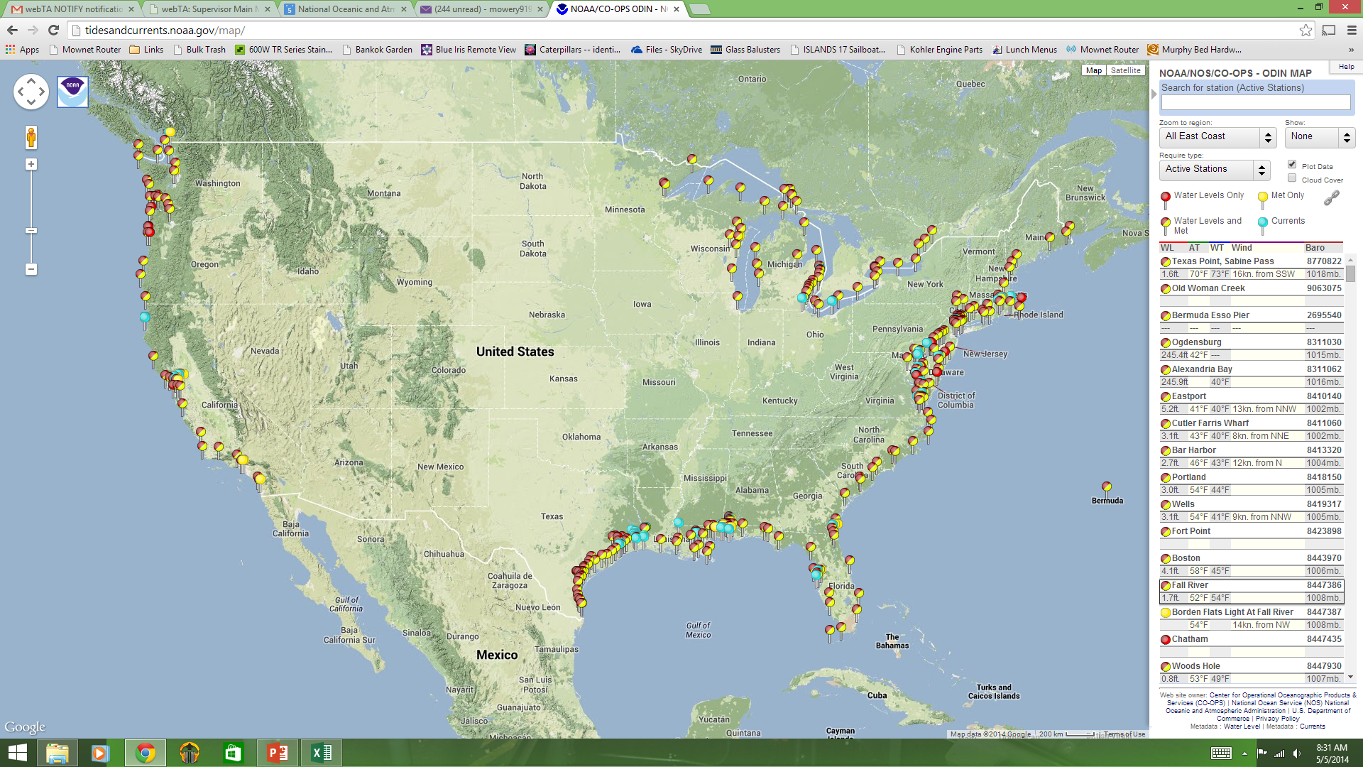
National Water Level Observations Program

Slide 4
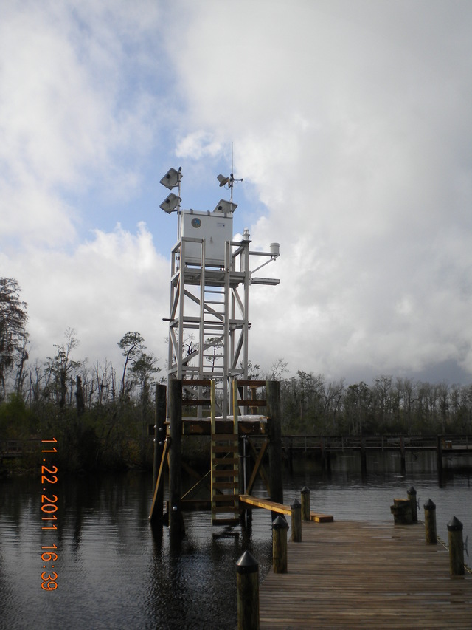
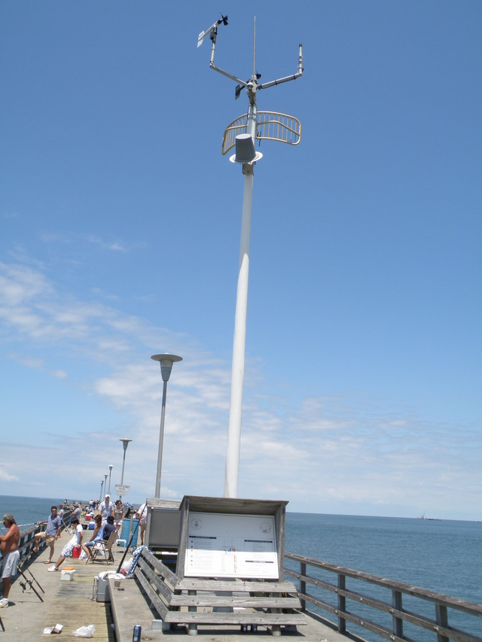
Typical CO-OPS Stations

Slide 5
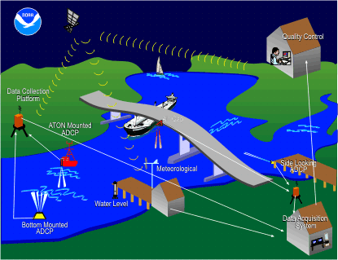
Physical Oceanographic Real-Time System (PORTS)
Charleston Harbor
Cherry Point
Chesapeake Bay North
Chesapeake Bay South
Delaware River and Bay
Houston/Galveston
Humboldt Bay
Jacksonville
Lake Charles
L.A./Long Beach
Lower Columbia River
Lower Mississippi River
Mobile Bay
Narragansett Bay
New Haven
New London
NY/NJ Harbor
Pascagoula
Port of Anchorage
Sabine Neches
San Francisco Bay
Soo Locks
Tacoma
Tampa Bay

Slide 6
Channel Use & Numbers
Channel Summaries
Channel | Period | Baud | Assigned | In Use
52W | hrly | 300 | 100 | 69
65E | 6-min | 300 | 60 | 59
69E | hrly | 300 | 69 | 64
72W | 6-min | 300 | 60 | 28
147E | 6-min | 300 | 66 | 64
148W | 6-min | 300 | 69 | 69
150W | 6-min | 300 | 60 | 60
159E | 6-min | 300 | 60 | 60
165E | hrly | 300 | 12 | 10
209E | 6-min | 300 | 60 | 50
213E | 6-min | 1200 | 48 | 47
225E | 6-min | 1200 | 12 | 7

Slide 7
Station Locations
Pacific Territories including
Guam, Samoa, Wake,
and Kwajalein

Slide 8
Functionality, Usage, and Outlook
Performance Experienced
Unique Applications / Mission
Future Plans

Slide 9
Contact Info
NOAA / NOS
Center for Operational Oceanographic Products and Services
Engineering Division
Systems Support and Evaluation Branch
Scott Mowery Warren Krug
757-842-4442 757-842-4424
Scott.Mowery@noaa.gov Warren.Krug@noaa.gov
672 Independence Parkway
Chesapeake, VA 23320

